Slide 1

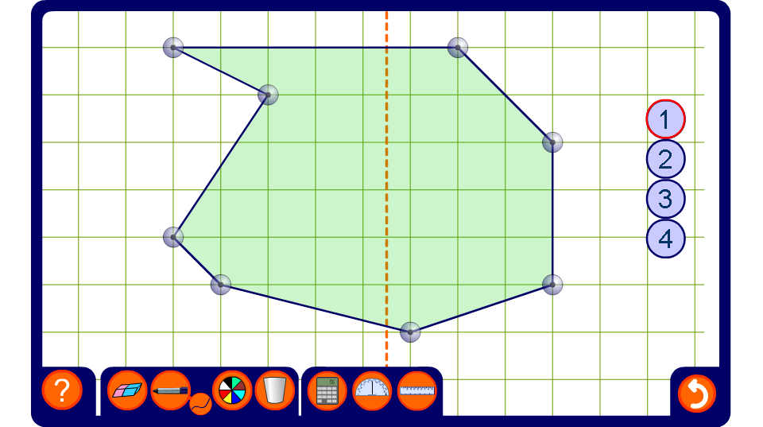


Make this shape symmetrical
Notes:
Ask a volunteer to come to the board and drag the vertices to make the shape symmetrical about the given mirror line.

